Slide 1
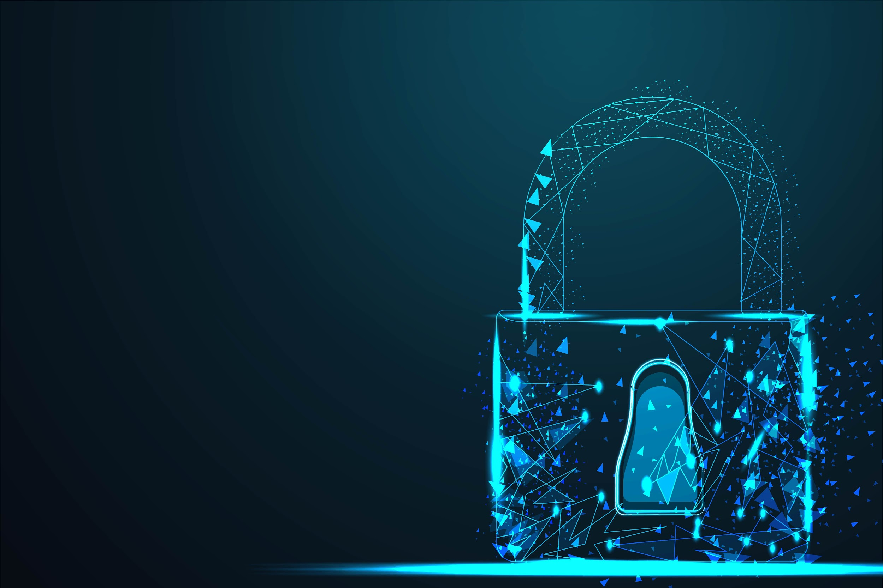
GROUP 7:
SMART LOCK
Hoàng Tuấn Anh
Trần Anh Tuấn
Trần Văn Hiệp

Slide 2
TIMELINE
I
II
Ý TƯỞNG
NỘI DUNG
III
IV
KẾT QUẢ
Q & A

Slide 3
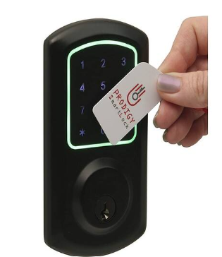
I. Ý TƯỞNG
Mở khóa bằng RFID và mật khẩu
Dễ dàng thao tác
Tính bảo mật cao
Smartlock use RFID and Keypad

Slide 4
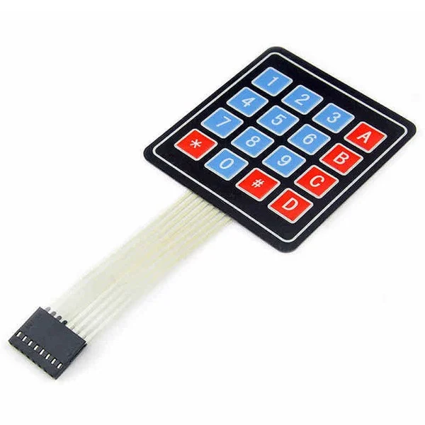
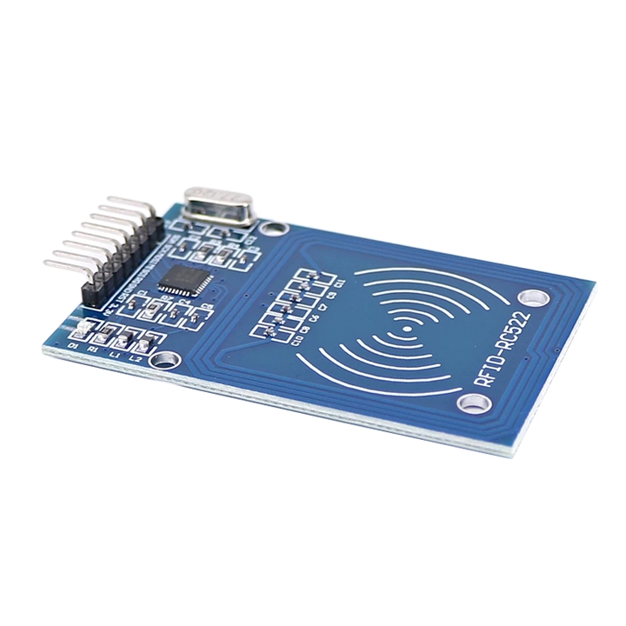

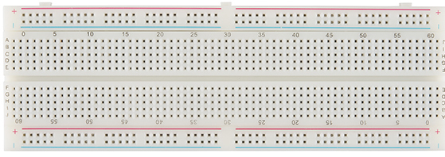
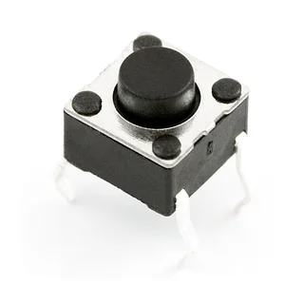
II. NỘI DUNG
Linh Kiện
Keypad
RFID-RC522 module
Arduino Uno R3
Breathboard
Button

Slide 5
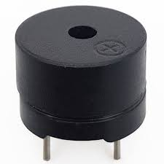
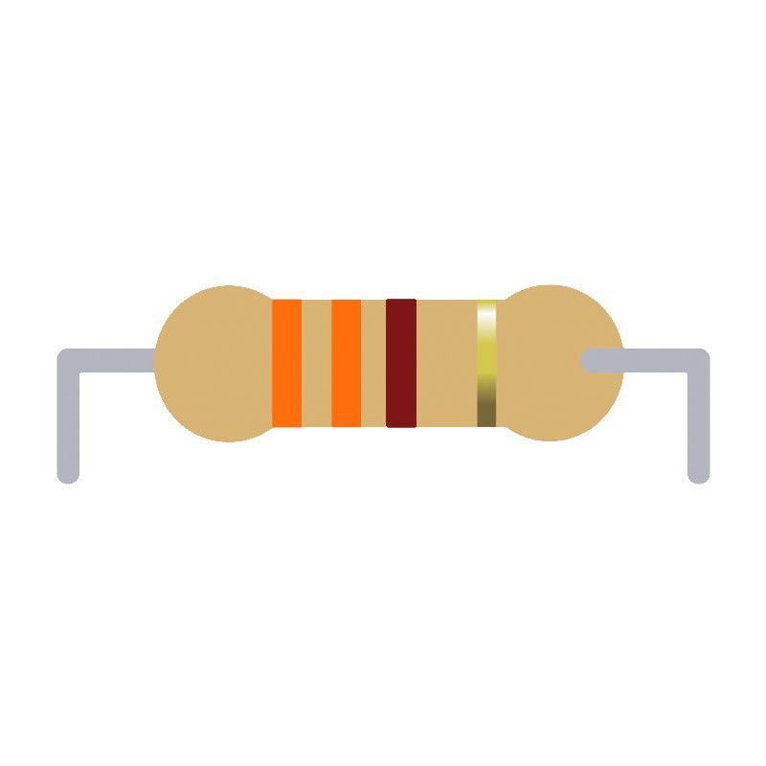
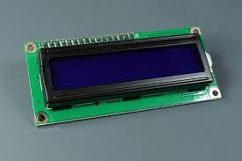
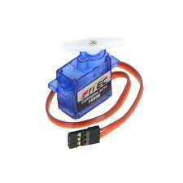
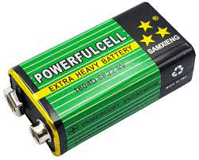
Trở vạch 1/4W 5%
330R
Buzzer
Liquid Crystal LCD I2C
Servo
Pin 9V

Slide 6
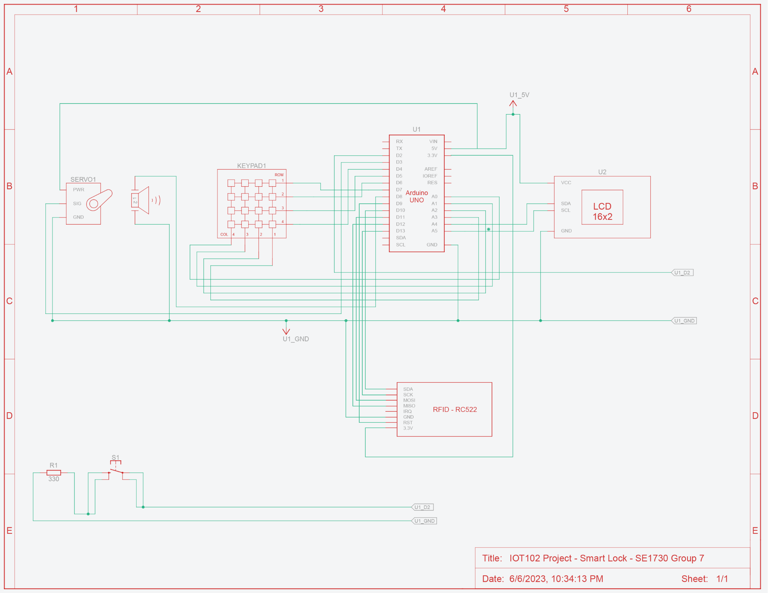
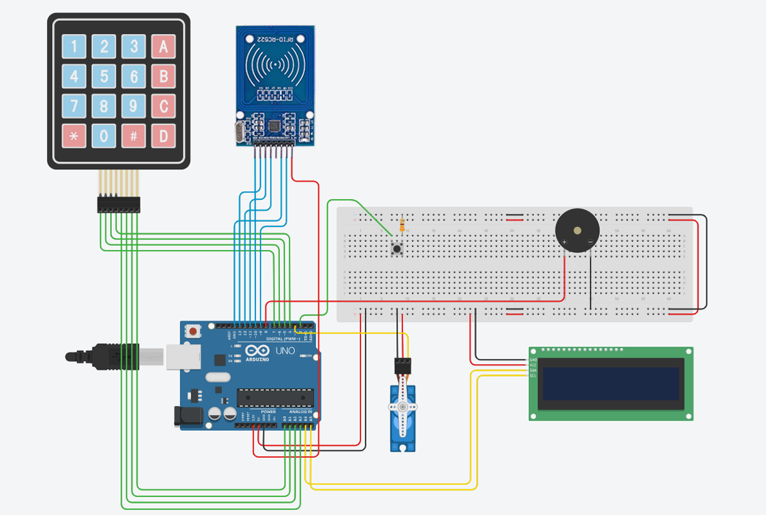
II. NỘI DUNG
2. Mạch
Mạch nguyên lý
Mạch kết nối

Slide 7
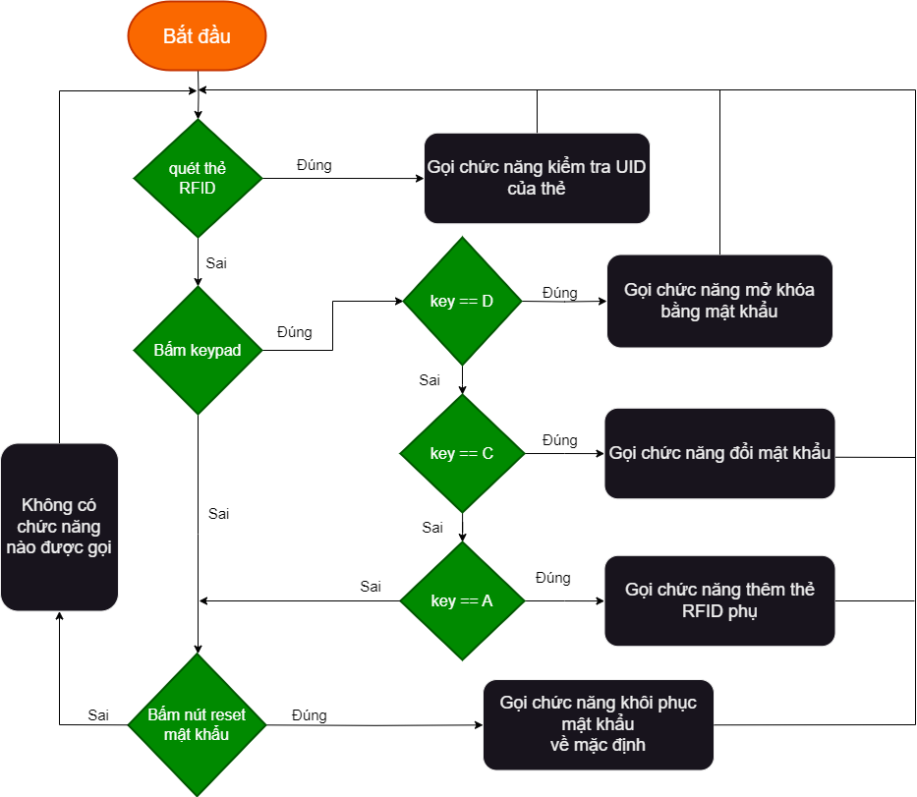
II. NỘI DUNG
3. Lưu đồ thuật toán

Slide 8
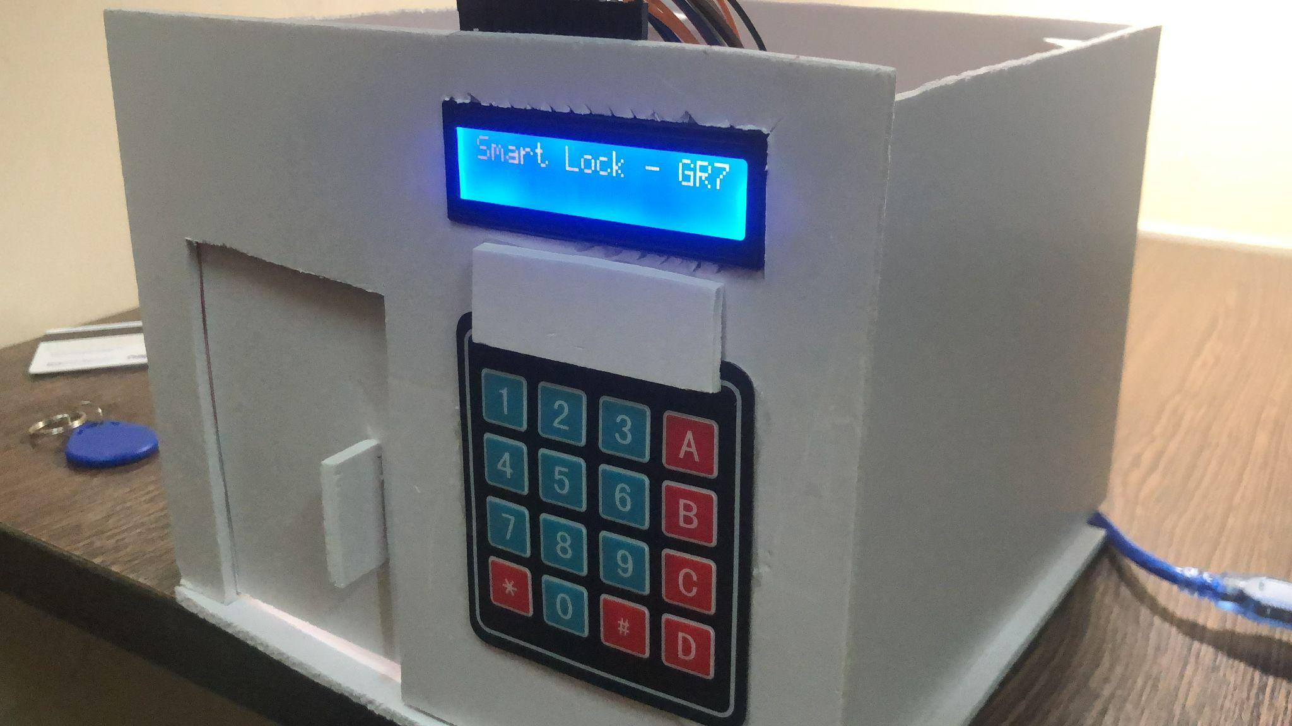
III. KẾT QUẢ

Slide 9

IV. Q&A

Slide 10
THANKS FOR LISTENING

Slide 11
OUR SOLUTIONS
MARS
NEPTUNE
JUPITER
SATURN
Despite being red, Mars is a cold place
It’s the farthest planet from the Sun
It’s the biggest planet in the Solar System
Saturn is the ringed one and a gas giant

Slide 12
MAIN COMPETITORS
NEPTUNE
MARS
VENUS
SATURN
It’s the farthest planet from the Sun
Despite being red, Mars is a cold place
Venus is the second planet from the Sun
It’s composed mostly of hydrogen and helium

Slide 13
COMPANY
01
You could enter a subtitle here if you need it

Slide 14
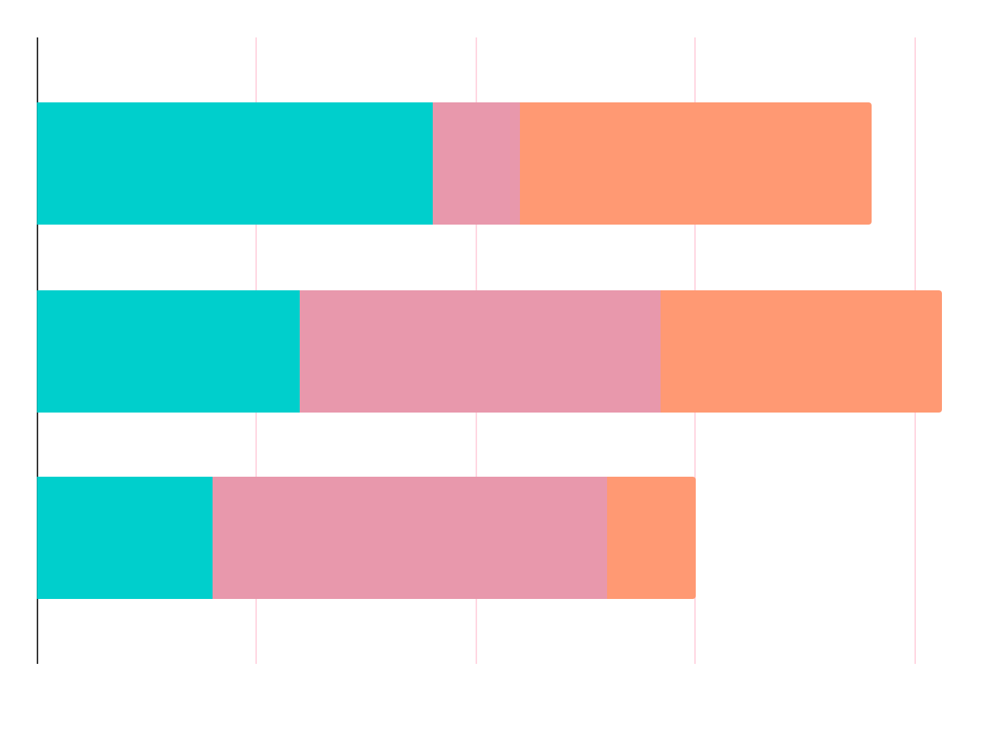
MARKET RESEARCH
NEPTUNE
MERCURY
SATURN
It’s the farthest planet from the Sun
Mercury is the closest planet to the Sun
Saturn is composed of hydrogen and helium

Slide 15
ANALYSIS
OUTREACH
TOP RATED VALUES
30%
80%
50%
Mars
Mercury
Saturn
Neptune
Venus

Slide 16
TARGET
GENDER
AGE
20-39
80%
40-60
50%
75%
Female
500,000+
Employees
60%
Male

Slide 17

A Picture Is Worth a Thousand Words

Slide 18
AWESOME WORDS

Slide 19
OUR PROCESS
MARS
SATURN
DAY 02
DAY 04
DAY 01
DAY 03
JUPITER
NEPTUNE
Despite being red, Mars is a cold place
Saturn is composed of hydrogen and helium
It’s the biggest planet in the Solar System
It’s the farthest planet from the Sun

Slide 20
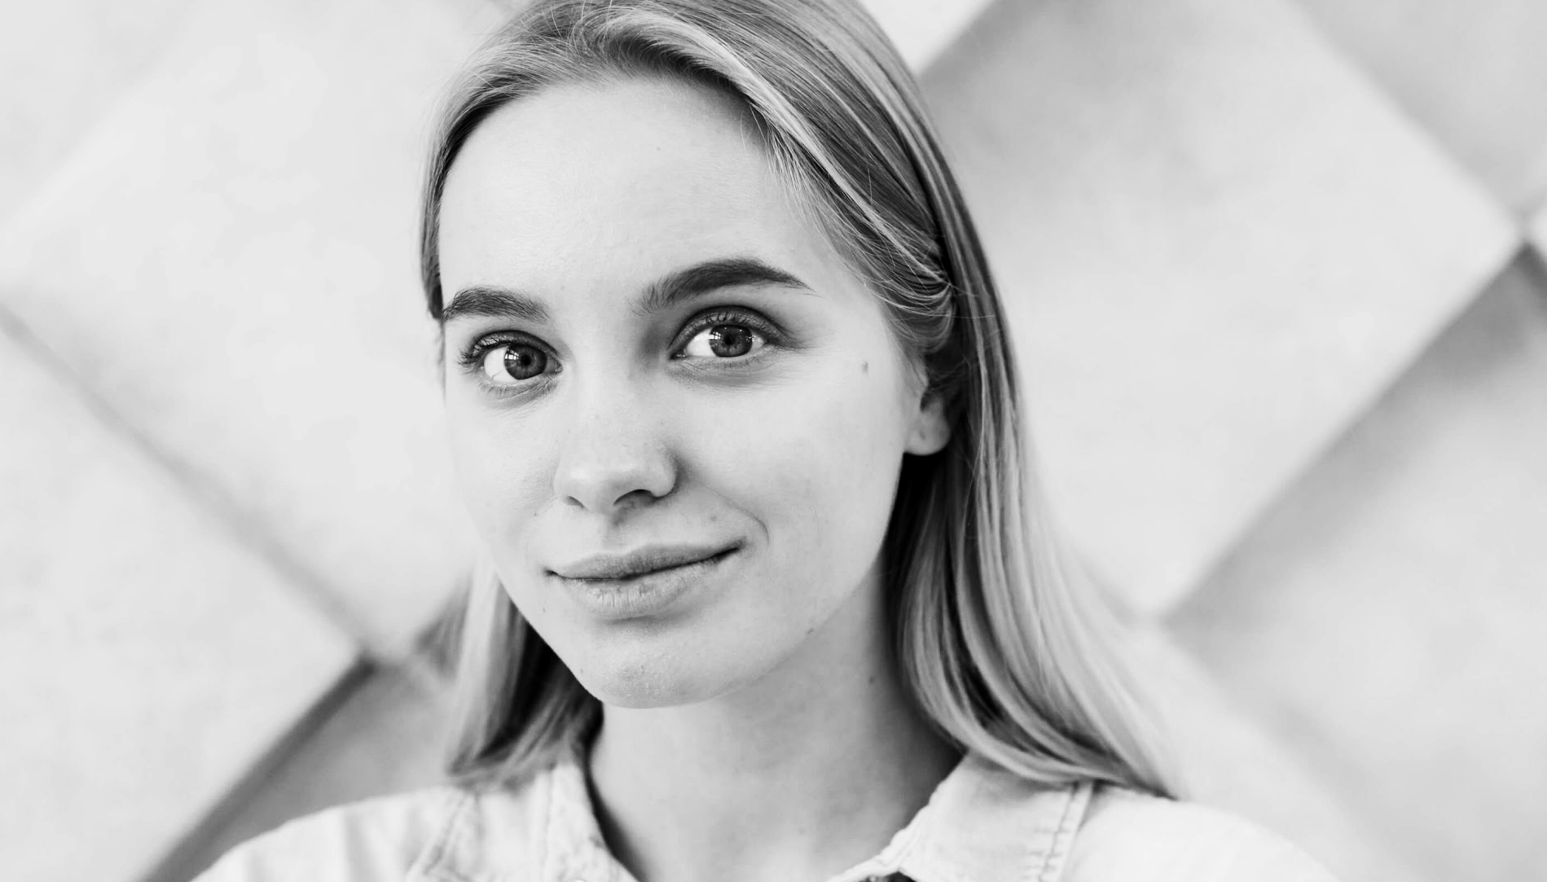
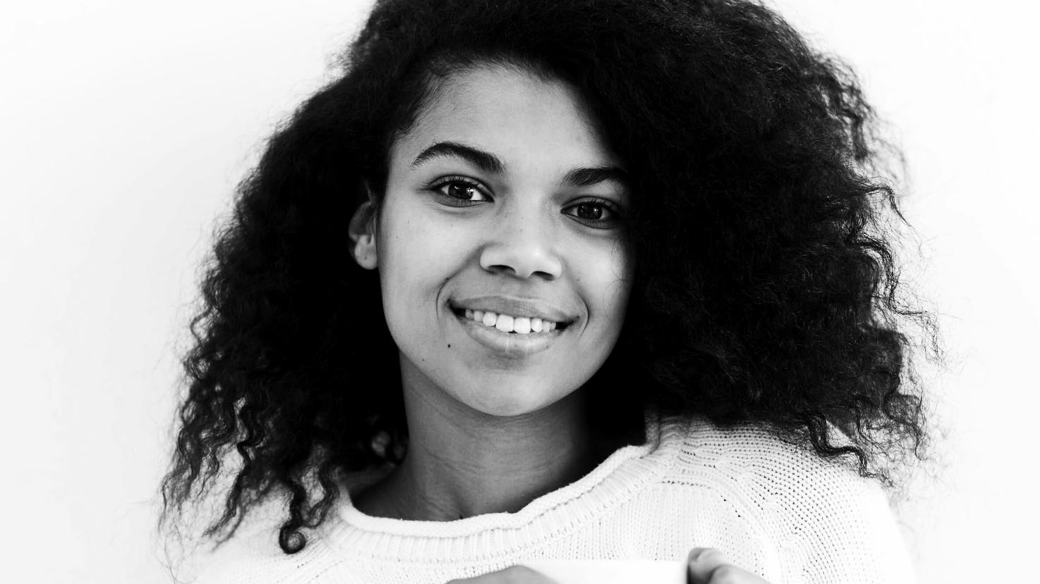
OUR CONSULTANTS
HELENA PATTERSON
JANE DOE
You can replace the image on the screen with your own
You can replace the image on the screen with your own

Slide 21
—SOMEONE FAMOUS
“This is a quote. Words full of wisdom that someone important said and can make the reader get inspired.”

Slide 22
OUR PARTNERS
VENUS
MARS
SATURN
MERCURY
Venus has an extremely poisonous atmosphere
Despite being red, Mars is actually a cold place
Saturn is composed mostly of hydrogen and helium
Mercury is the closest planet to the Sun

Slide 23
TESTIMONIALS
—RYAN DIXON
—ALIYA FARLEY
—HENRY McKANE
—BILLY BROOKS
—LUCY JADE
—ROSE CLARK
“Mercury is the closest planet to the Sun and the smallest of them all”
“Venus has a beautiful name and is the second planet from the Sun”
“Jupiter is a gas giant and the biggest planet in the Solar System”
“Saturn is composed mostly of hydrogen and helium”
“The Sun is the star at the center of the Solar System”
“Neptune is the fourth-largest planet in the Solar System”

Slide 24
4,498,300,000
Big numbers catch your audience’s attention

Slide 25
AWARDS
 | DATE | REASON | DESCRIPTION
MERCURY | 2010 | Jupiter | It’s the closest planet to the Sun and the smallest one
MARS | 2012 | Neptune | Despite being red, Mars is actually a cold place
VENUS | 2016 | Saturn | It has a nice name and is the second planet from the Sun

Slide 26
UPCOMING GOALS
JUPITER
SATURN
NEPTUNE
JUNE 2
OCTOBER 14
JANUARY 23
It’s the biggest planet in the Solar System
Saturn is composed mostly of hydrogen and helium
Neptune is the farthest planet from the Sun

Slide 27
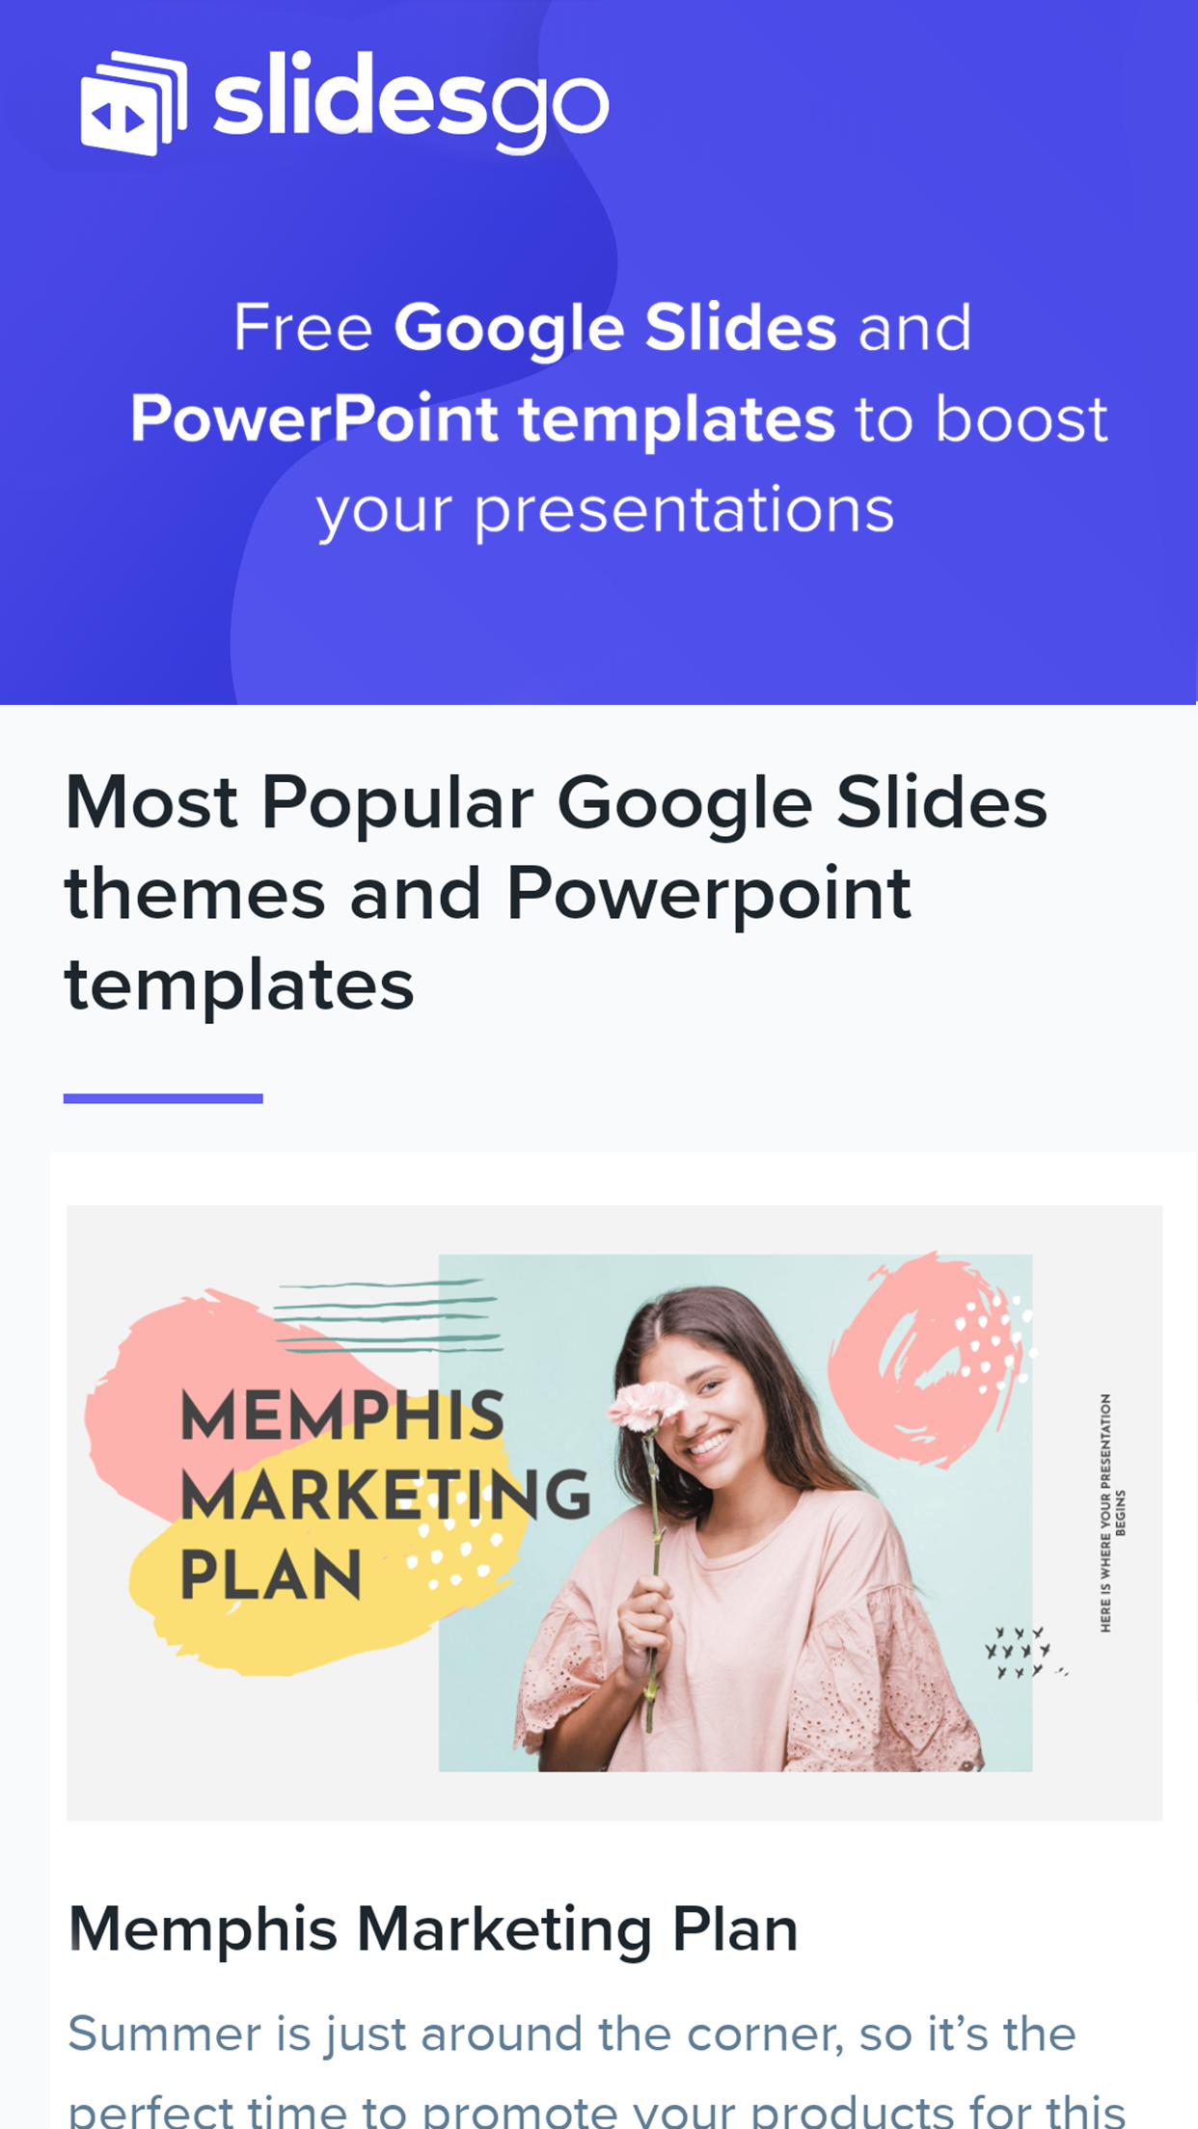
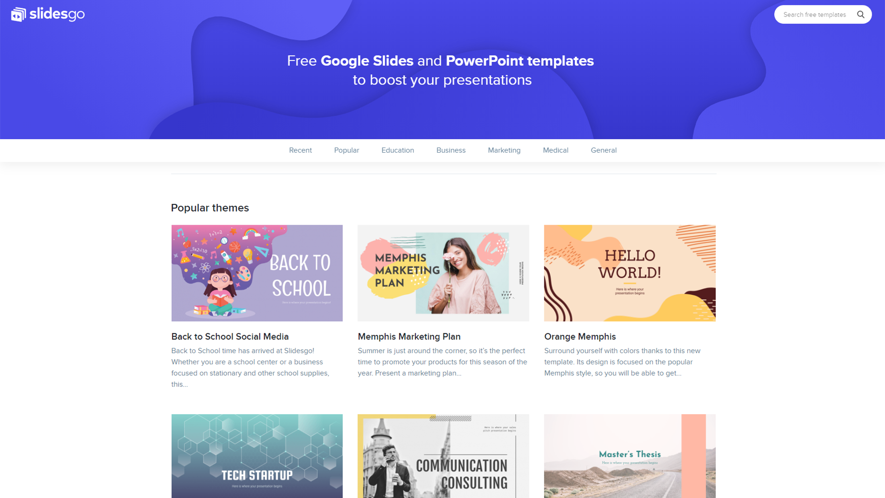
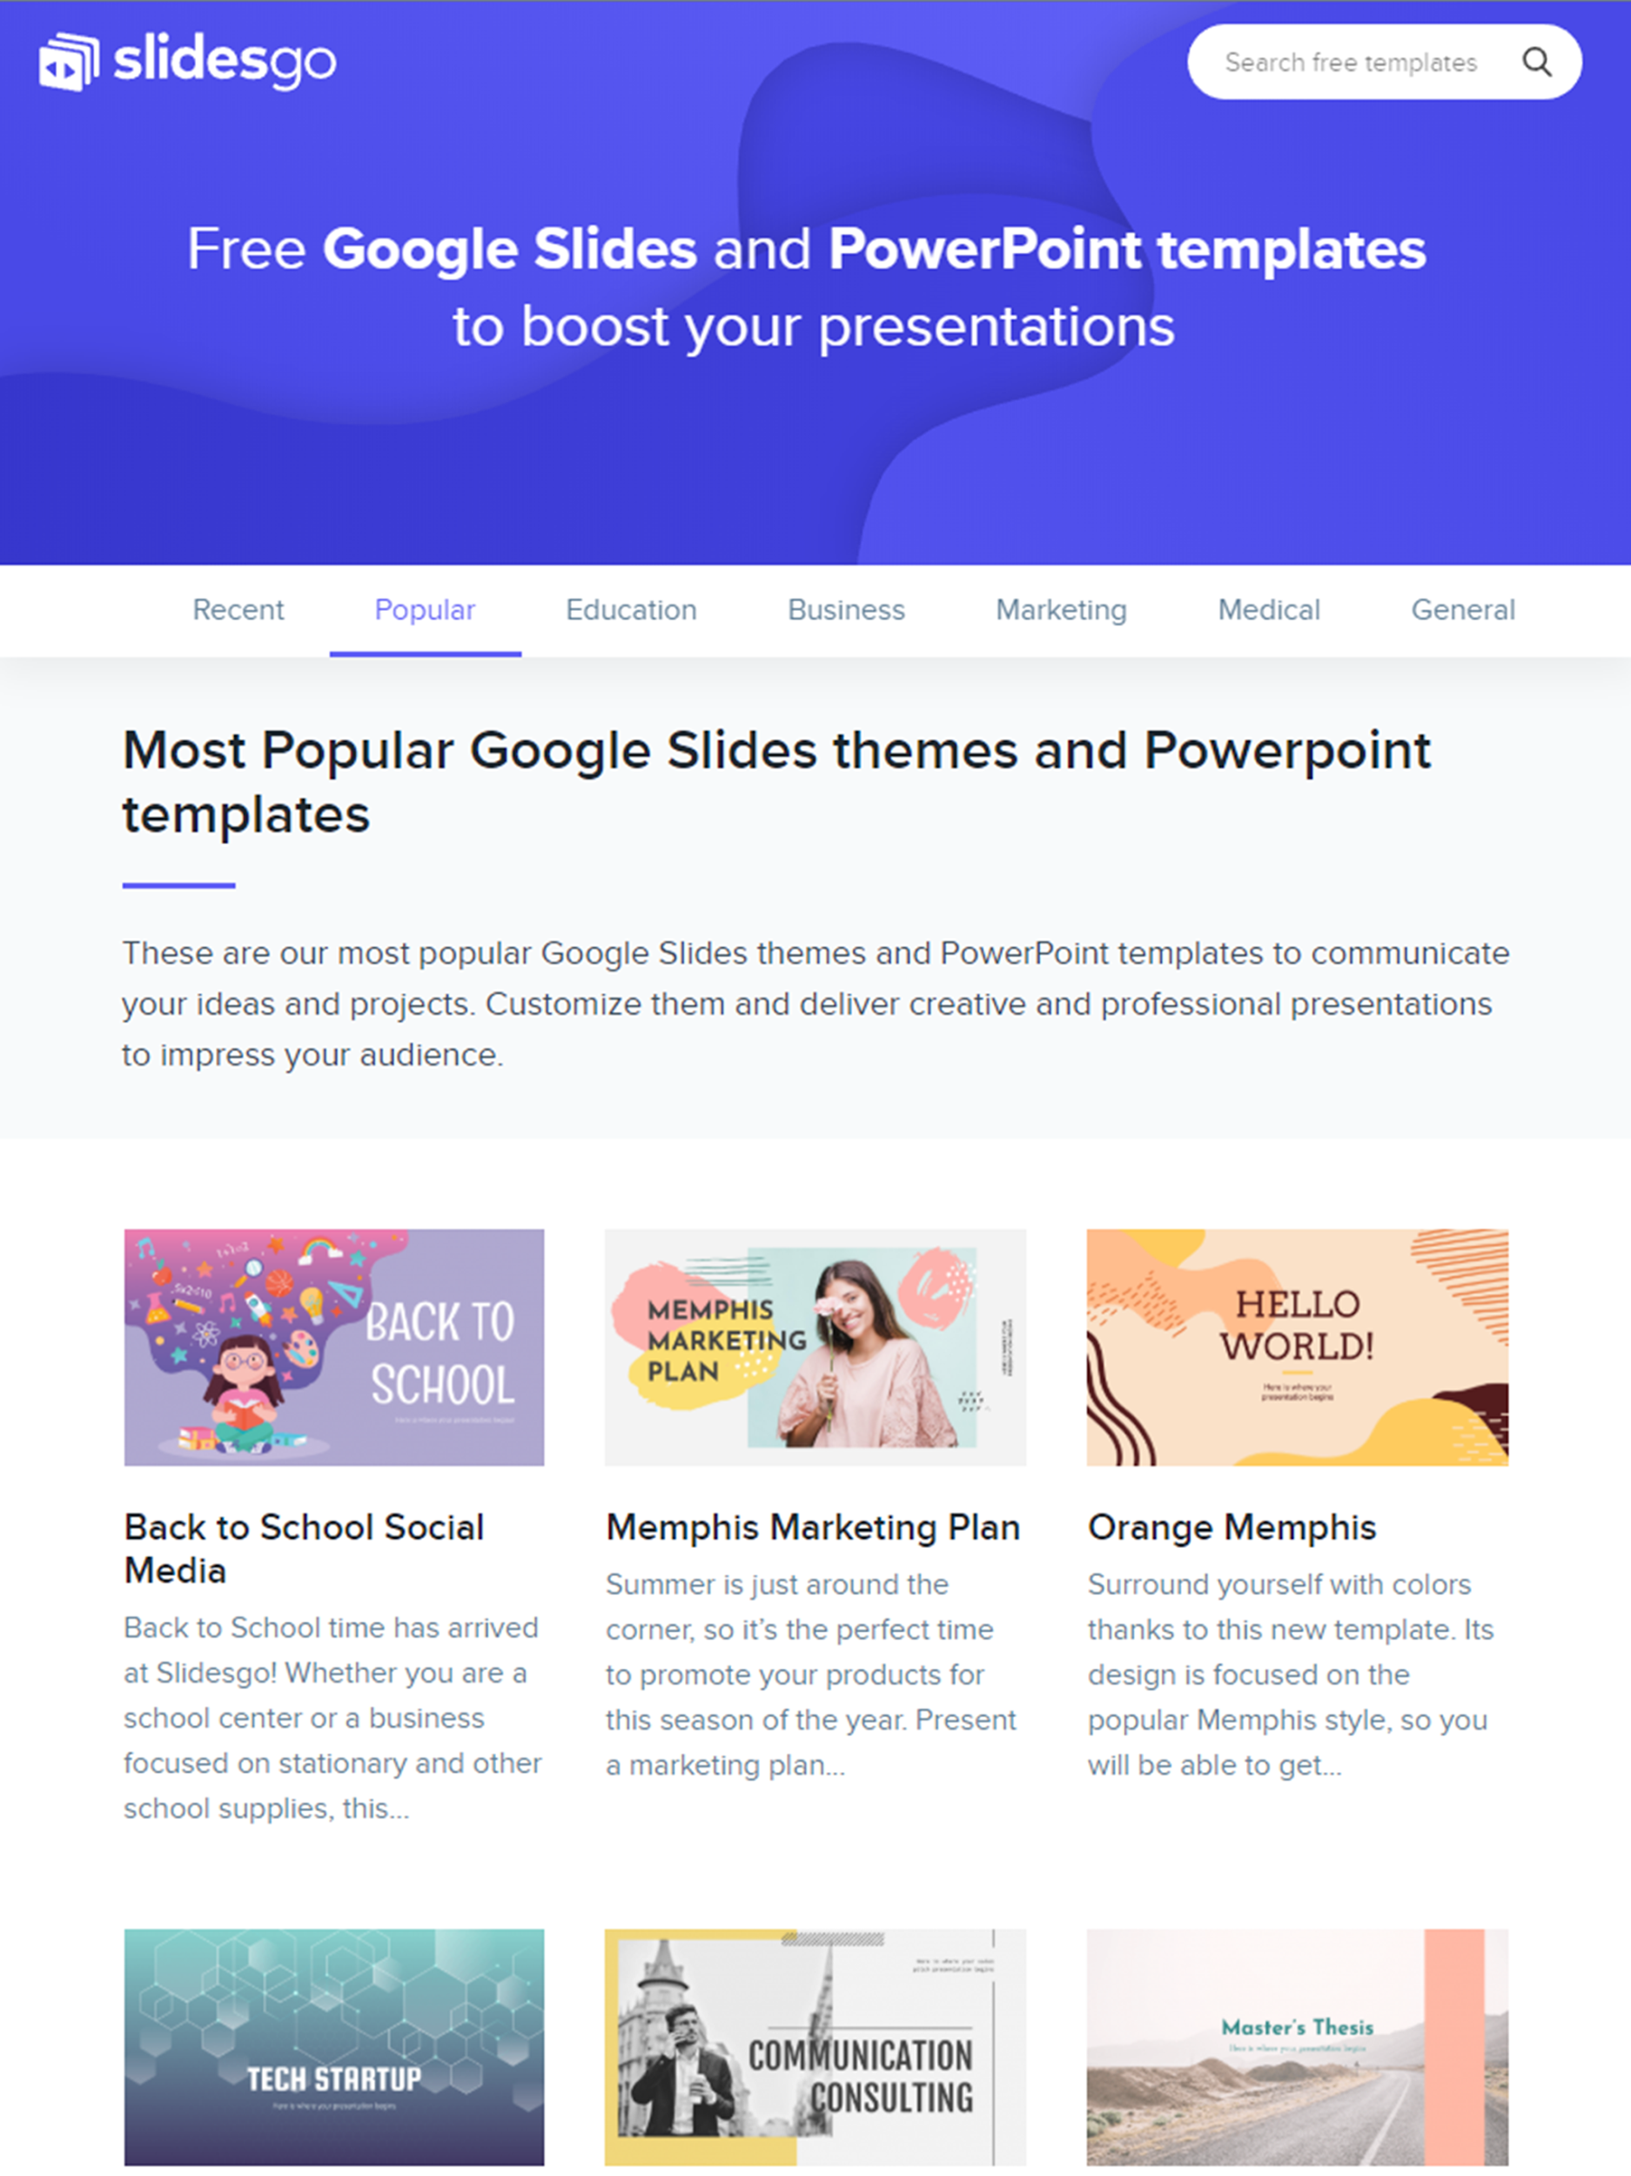
SNEAK PEEK
You can replace the images on these screens with your own work

Slide 28
THANKS
Do you have any questions?
youremail@freepik.com
+91 620 421 83
yourcompany.com
Please keep this slide for attribution

Slide 29
ALTERNATIVE RESOURCES

Slide 32
...and our sets of editable icons
You can resize these icons without losing quality.
You can change the stroke and fill color; just select the icon and click on the paint bucket/pen.
In Google Slides, you can also use Flaticon’s extension, allowing you to customize and add even more icons.

Slide 34
...and our sets of editable icons
You can resize these icons without losing quality.
You can change the stroke and fill color; just select the icon and click on the paint bucket/pen.
In Google Slides, you can also use Flaticon’s extension, allowing you to customize and add even more icons.

